Slide 1
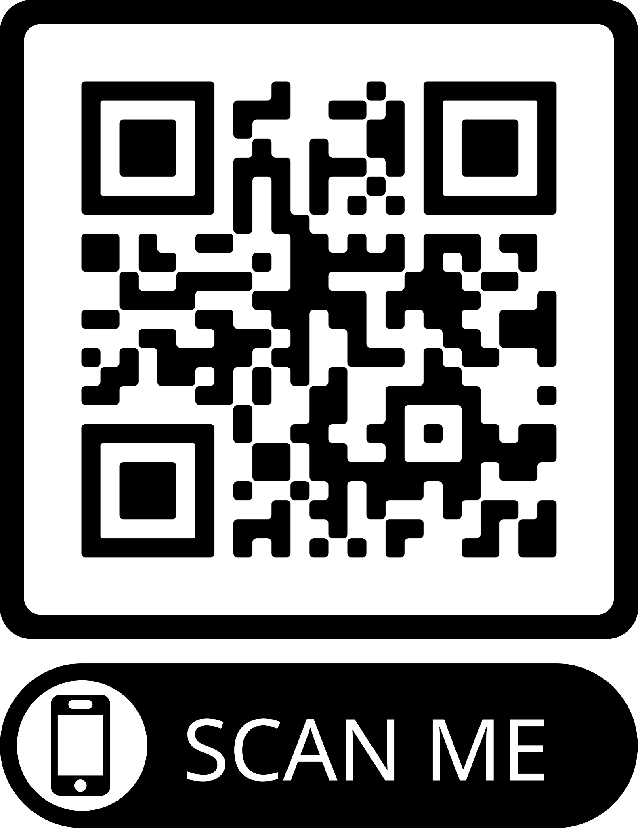
BeeHive
Presented by Team 2
Satvik Verma
Matthew Hernandez
Benjamin Dinh
Sungmu Cho
Aaron Pham
Pearl Anyanwu

Slide 2
OUR COMPANY
BeeHive
Beehive is a comprehensive social media application, meticulously tailored for the unique needs of SFSU students. It serves a dual purpose, facilitating personal connections and streamlining on-campus employment prospects.

Slide 3
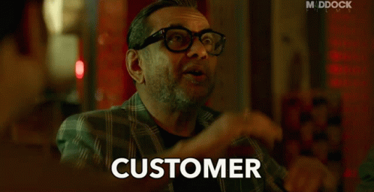
Customers
SFSU Students
Our main audience is focused onto the SFSU population.
We want to enhance the SFSU student experience, providing an engaging, productive, and enjoyable experience.
We want to empower our customers to effortlessly find part-time work, internships, and campus events that resonate with their interests and skill sets.

Slide 4
Benefits
Encourages meaningful interactions among students, establishing it as an invaluable tool for personal and professional advancement
Enhances the overall SFSU experience by facilitating student engagement with campus life

Slide 5
Conduct Project Management
Decision Making Process
Communication
Flexibility
Identify the decision to made
Analyze the issue after gathering information
Discuss potential solutions
Implement the solution based on final decision
Review and evaluate the outcome
Define each role of the team members
Respect all opinions to encourage teamworks
Develop/Plan routine to prioritize works to do
Set clear goals as a team
Plan short-term goals
Predict potential changes
Trust your team members

Slide 6

Manage Source Codes
Our team’s version control system: Git
Git makes it easier to make changes because developers can create different branches without messing up the main project.
Git ensures data integrity and allows developers to check files to make sure they haven't been tampered with, so we can keep our code safe.
Git has a large and active group of users. This leads to lots of helpful resources, and ways to connect it with other tools such as VS codes.

Slide 7
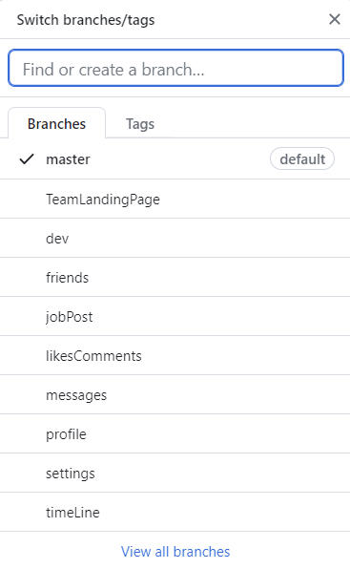
Git Management
Our team has made editing code more convenient by creating branches in Git corresponding to each feature.
For example, the 'dev' branch is a branch for verifying whether all changes work well, allowing for checking if there are any errors before ultimately merging into the main branch.

Slide 8
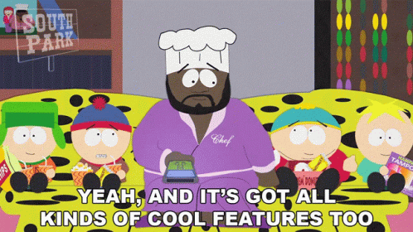
Features
User Experience ( Add Post, Edit Bio )
Messaging ()
Adding / Viewing Friends ()
Job Postings ( )
Privacy ( Hide Likes / Comments )
Dark Mode ()

Slide 9
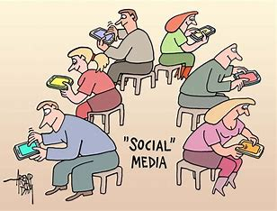
UX
Users will be able to post an image and look at others posts
Able to send friend requests and add others as friends
Change your profile picture and bio to your liking
Create job postings therefore it can been seen by others
Chat between friends
Able to change the theme of the application from dark or light

Slide 10
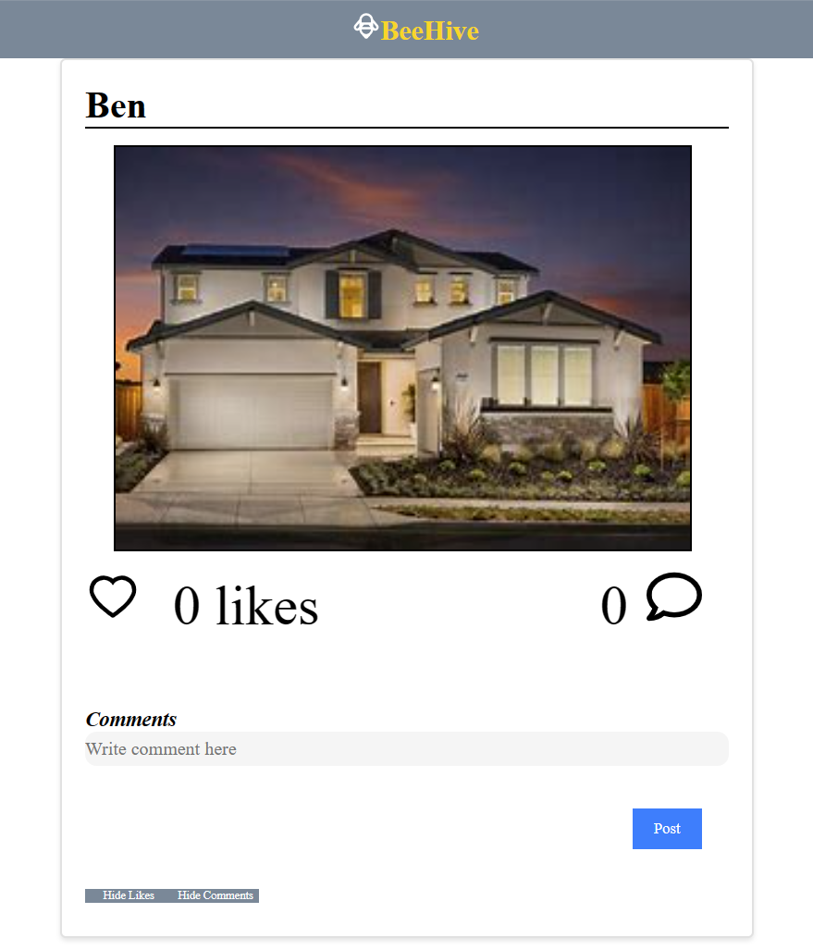
Home
Users can share photos with other users with posts
Through the likes and comments feature, able to interact with other users
Users can also hide likes and comments

Slide 11
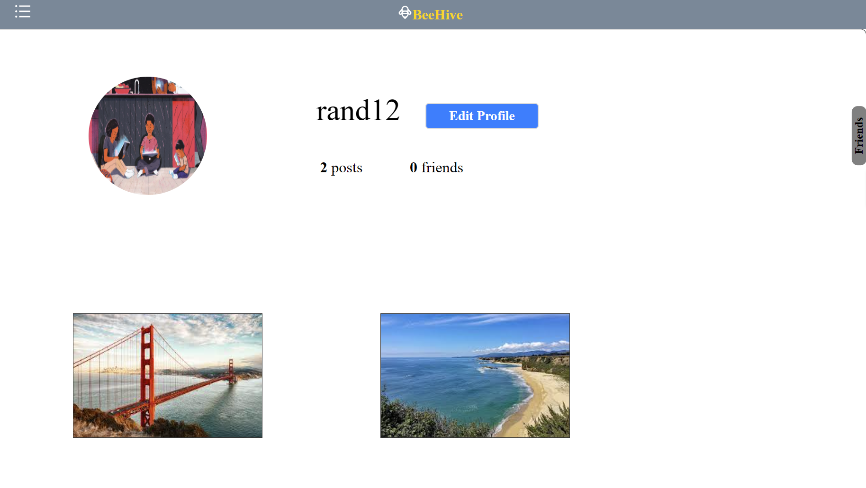
Profile

Slide 12
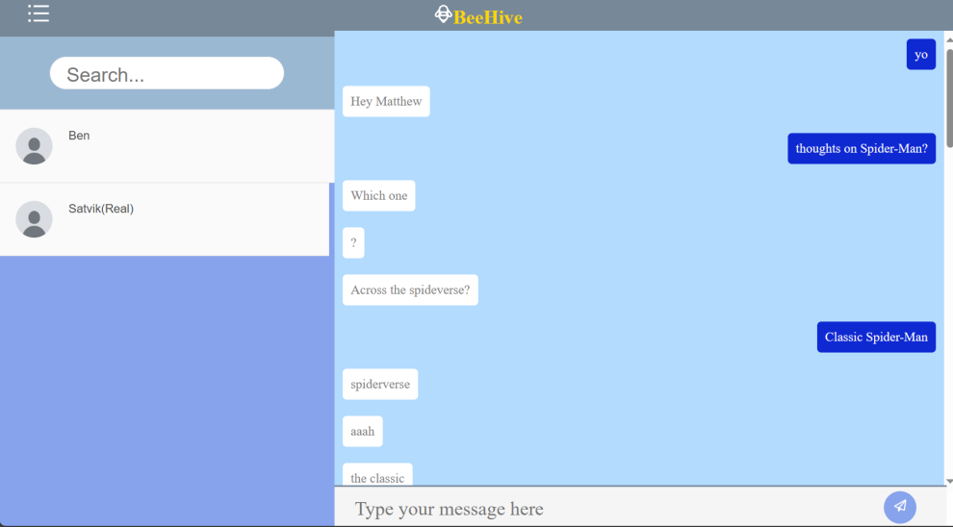
Messages

Slide 13
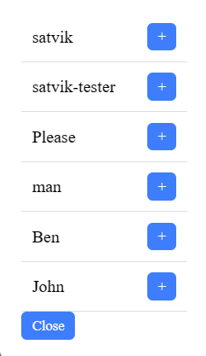
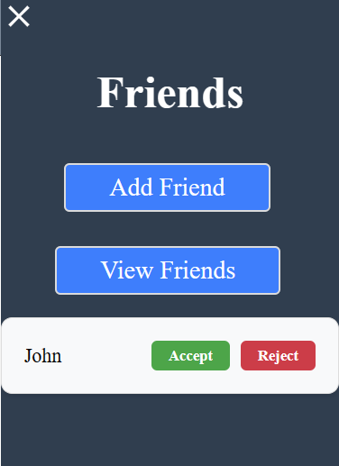
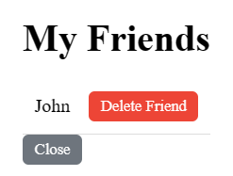
Friends

Slide 14
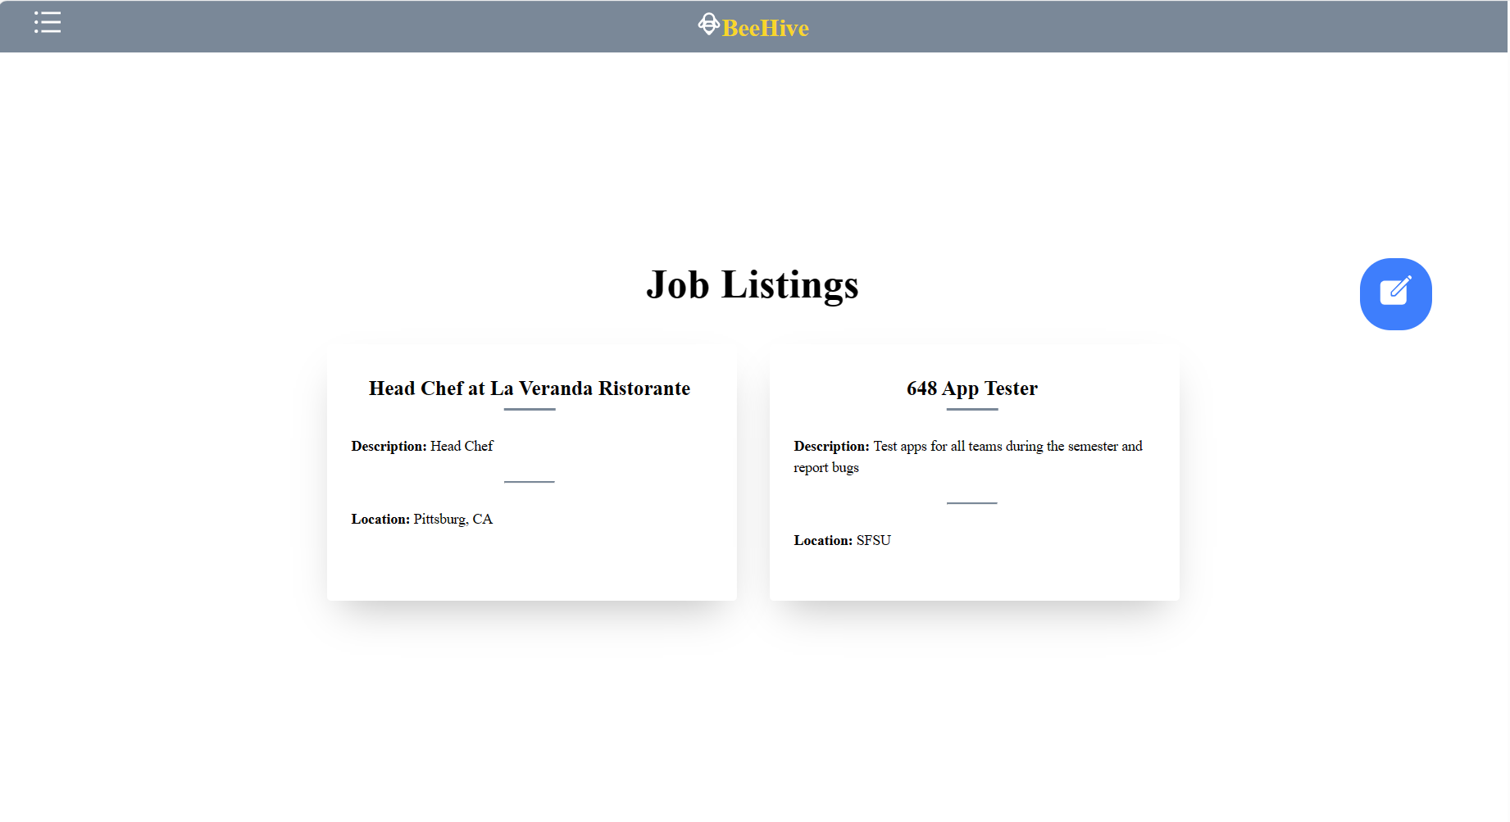
Job Lists

Slide 15

How To Build a Team
1. Accessing the strengths and weaknesses of the members and filling in the gaps
2. Identifying skills and matching tasks to their abilities
3. Organizing events that encourages camaraderie and improves team spirit ( Lunch, Local meetings, etc )
4. Communicating effectively and frequently

Slide 16

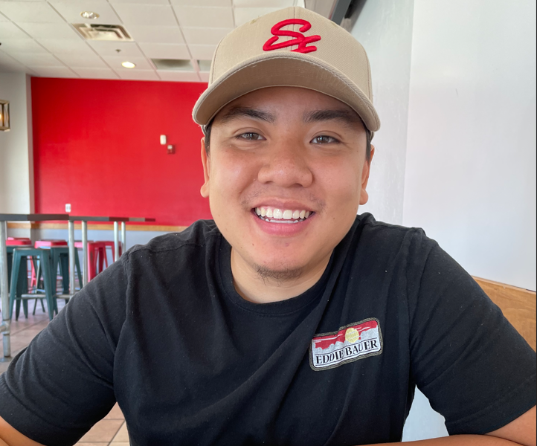

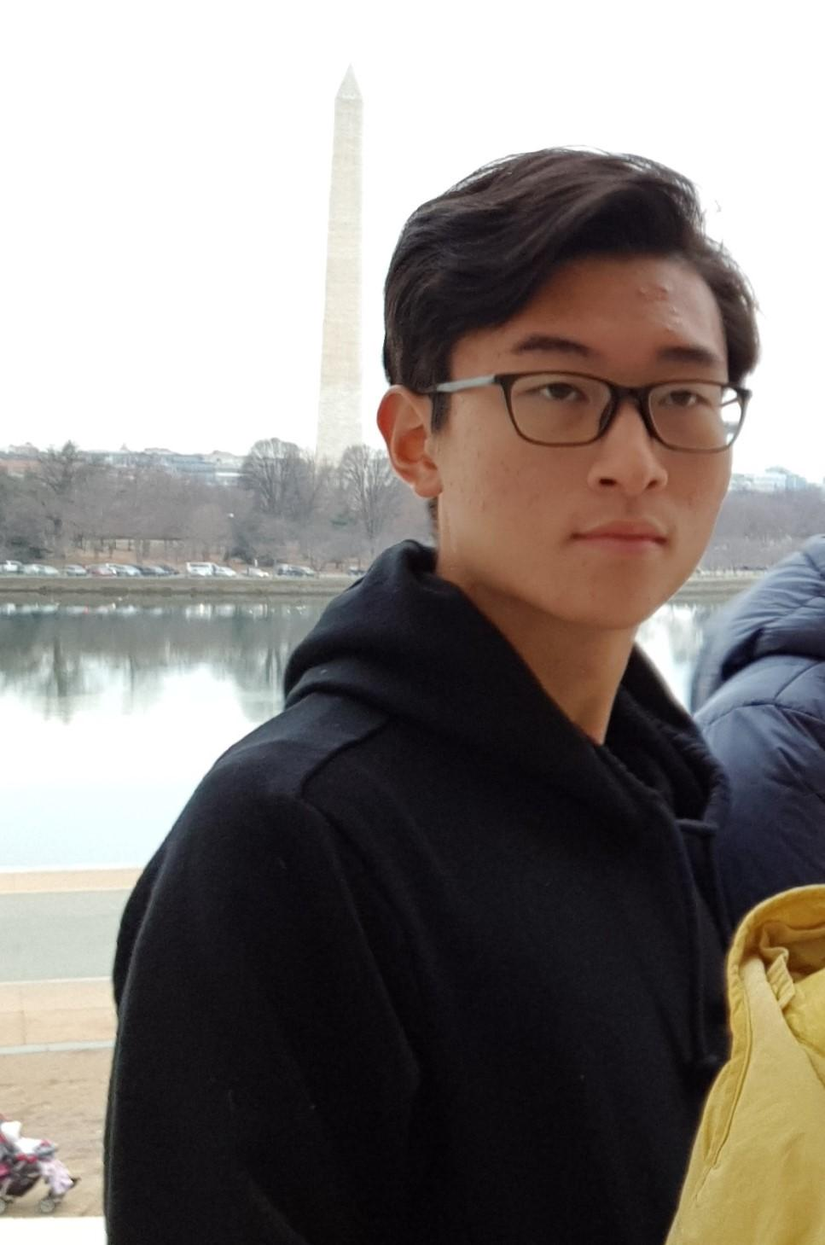
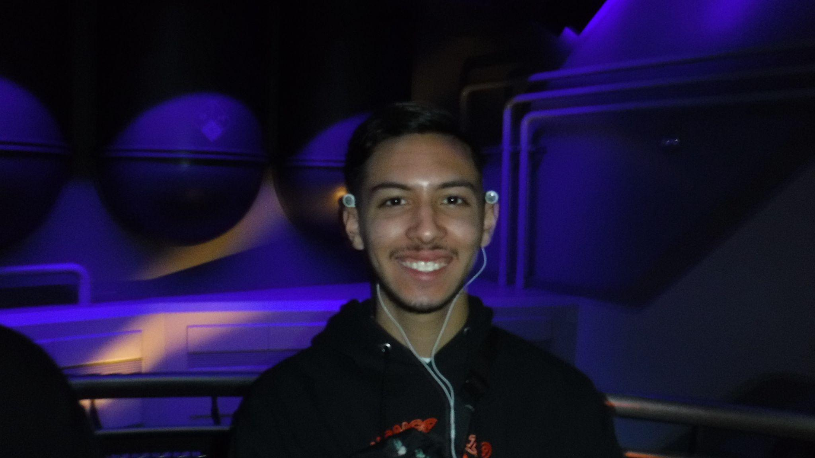
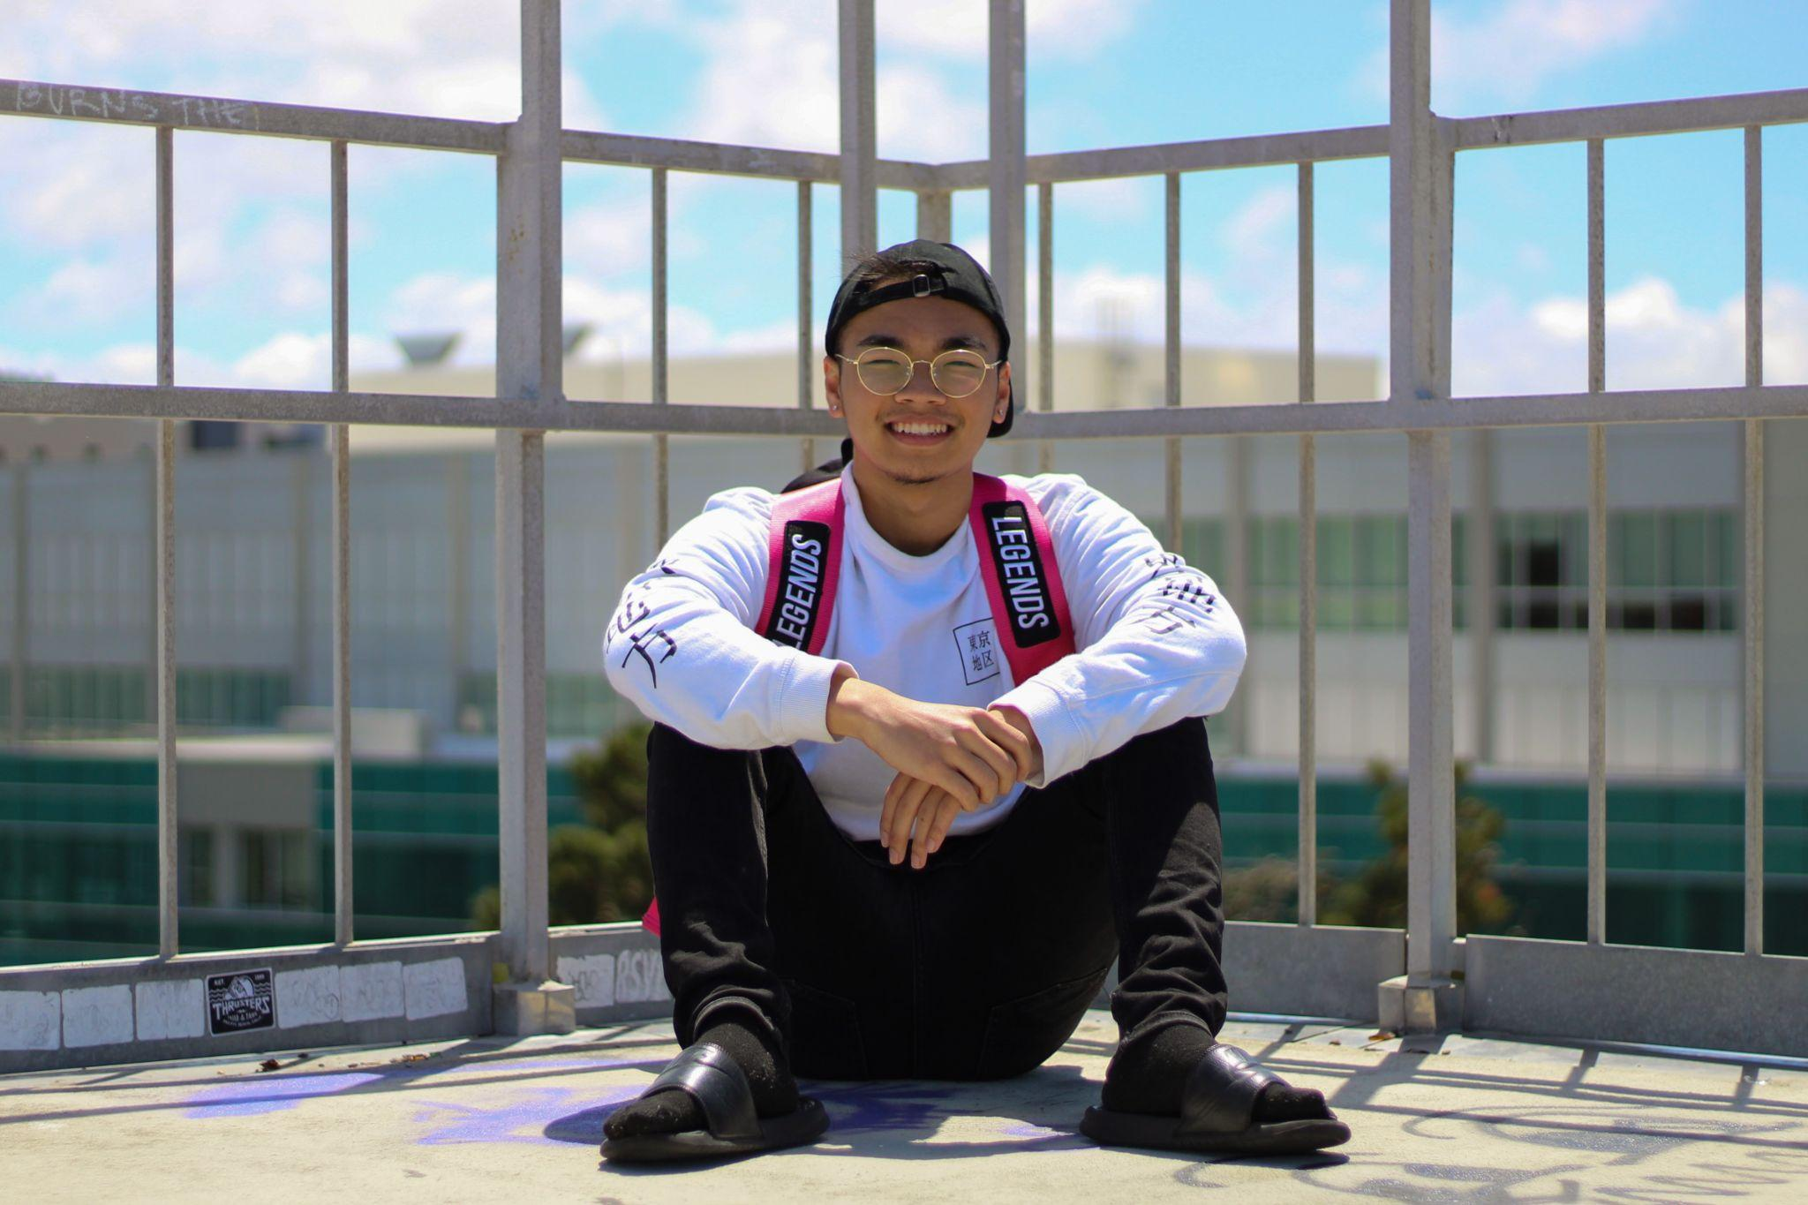
THE TEAM
Satvik
Pearl
Ben
Sungmu
Matthew
Aaron
Team Leader
Scrum Master
Couldn’t Find ur Pic, send to me or insert your pic here!
Front End Lead
Back-End Lead
Github Master
2nd Front End Lead

Slide 17
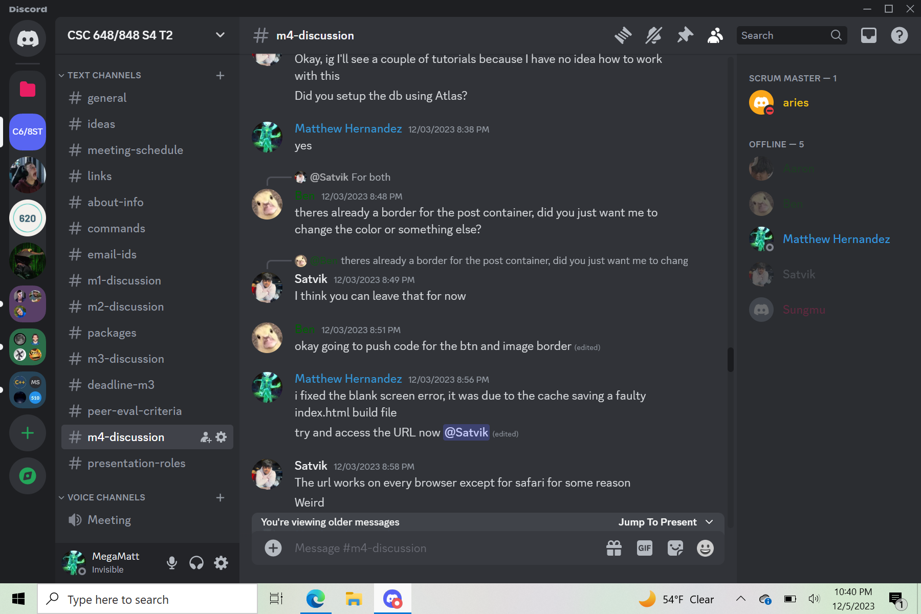
Communication
Primarily, Discord was used as our method of communication and organization.
Since Discord is so versatile, communicating through the one Discord Server proved extremely useful.

Slide 18
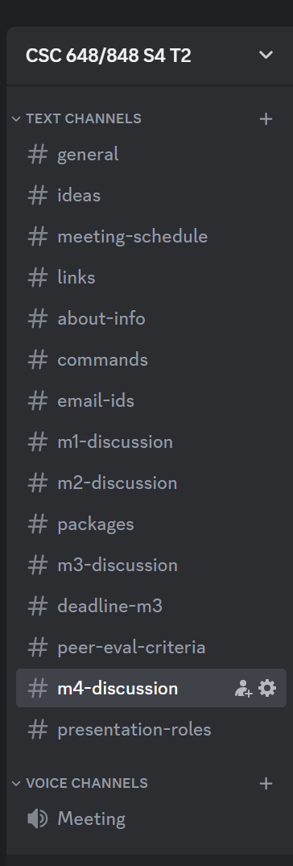
Communication
Individual Channel per Milestone
Channel solely for packages needed to install
1 voice channel for remote meetings, useful for when teammates were sick, busy with other tasks/errands

Slide 19
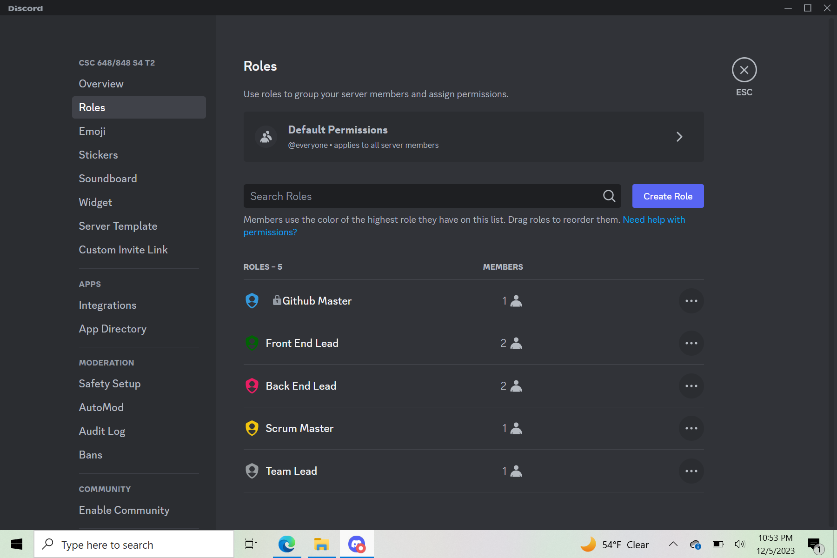
Communication
We created specific roles for every team member for clear understanding of what everyone’s jobs are.
This allowed for easy “pinging” of members and associating tasks with roles.

Slide 20
Future Possibilities
Our envisioned trajectory for this application is to transform it into an accessible mobile version. This would allow more students to download and utilize it as a versatile platform, seamlessly blending social connectivity with employment opportunities.

Slide 21
THANKS FOR LISTENING!
Does anyone have any questions?

